Slide 1




High Altitude Ballooning Communication Stability
Greg Wilburn
Rolfe Bode
Susan Brew
University of Arizona, Tucson, AZ
16 April 2016

Slide 2
Why Ballooning?
Scientific research:
  Telescopes
  Weather/ atmosphere data
Low space tourism
All done at much lower costs than traditional methods

Slide 3
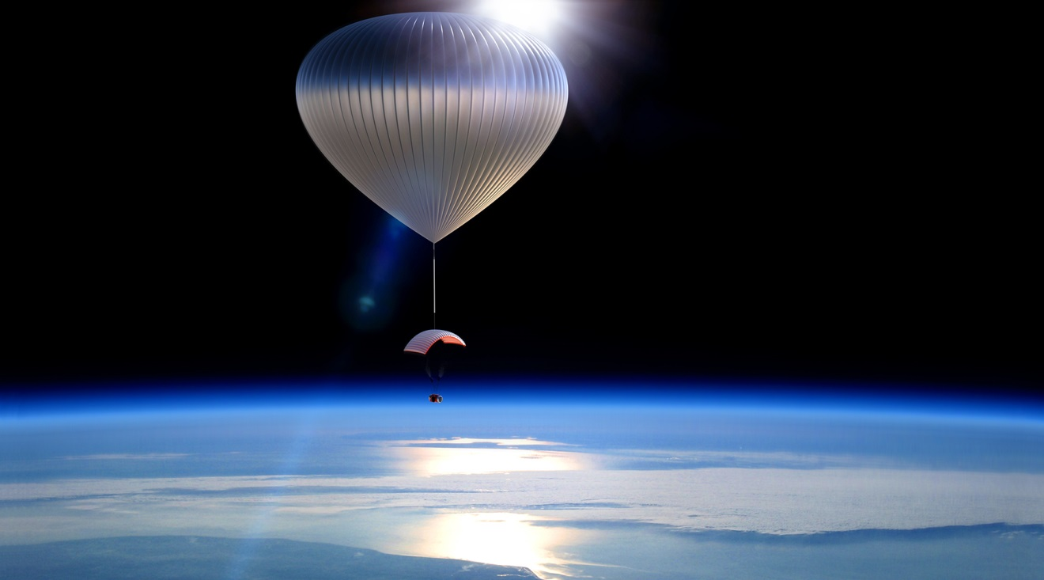
Voyager Capsule
Voyager Capsule picture

Slide 4
The Problem
Must communicate with balloons 100,000 feet in air
4 YAGI antennas mounted to ground based Mobile Command Center (MCC)
Without reliable mounting, significant data may be lost
  Needed for sensitive missions
Previous solution broke down

Slide 5
Objectives
Design stable antenna mounting system to communicate with balloons
Includes updating existing infrastructure and designing new system

Slide 6
Methods
Define Requirements
Research existing solutions
Create preliminary design in SolidWorks
Preliminary Design Review (PDR) to engineers at World View
Finalize design and cost report

Slide 7
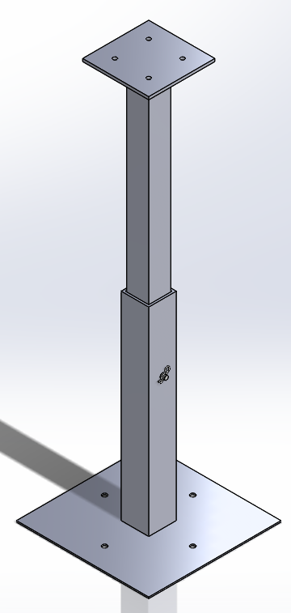
Final Design
2 galvanized square steel tubes
  Inner tube: 2.25”x2.25”x3’
  Outer tube: 2.5”x2.5”x1.5’
2 A36 steel plates
  Top plate: 6”x6”x.25”
  Bottom plate: 12”x12”x.1875”
Slide inner tube into bottom prior to each flight

Slide 8
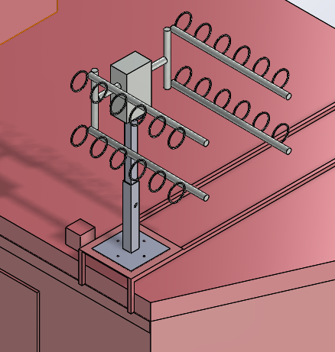
Final Design (cont’d)
Bottom tube remains mounted to MCC infrastructure
Deflection of .294”
  Under max wind load of 60 mph
  Angle of deflection: .618º

Slide 9
An Engineering Learning Experience
Keep It Simple, Stupid
Decided on straightforward, cost effective design
COTS solutions far too expensive for the appllication

Slide 10
THANK YOU!
With special thanks to my mentor, Rolfe Bode, and engineers Zane Maccagnano, Tim Basta and Kyler Felton

